Slide 1

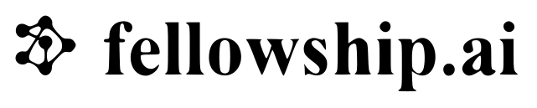
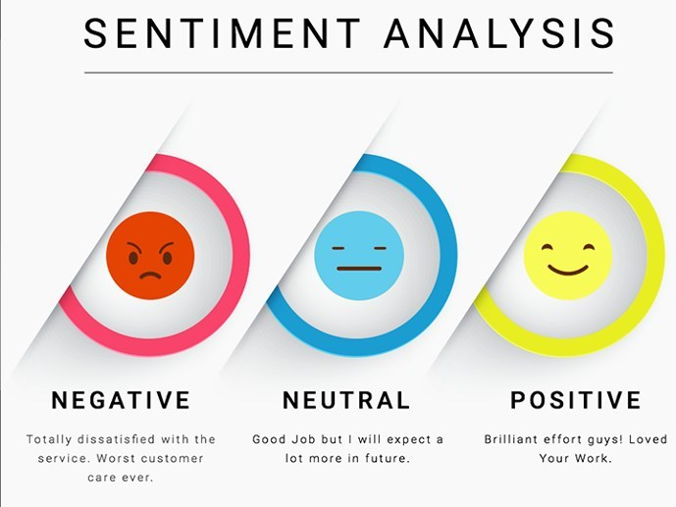
AIRLINE

Slide 2
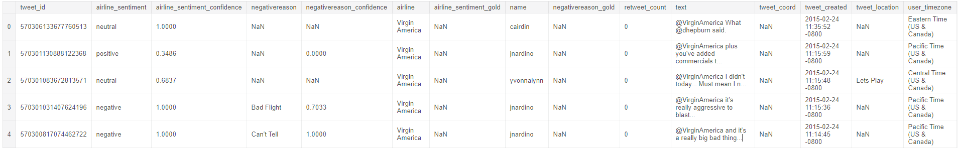
Data (columns)
tweet_id
airline_sentiment
airline_sentiment_confidence
negativereason
negativereason_confidence
airline
airline_sentiment_gold
name
negativereason_gold
retweet_count
text
tweet_coord
tweet_created
tweet_location
user_timezone

Slide 3
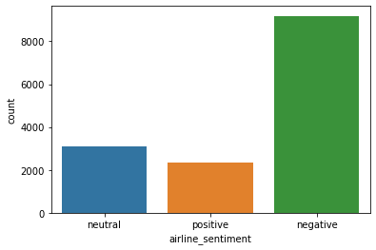
Class Imbalance

Slide 4
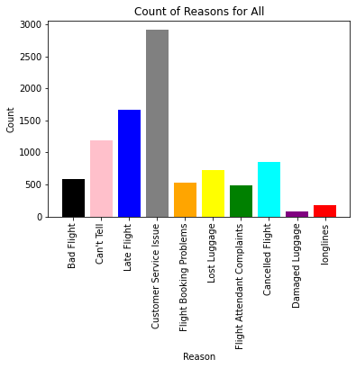
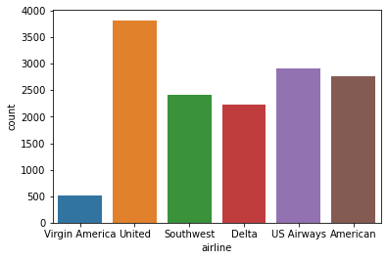
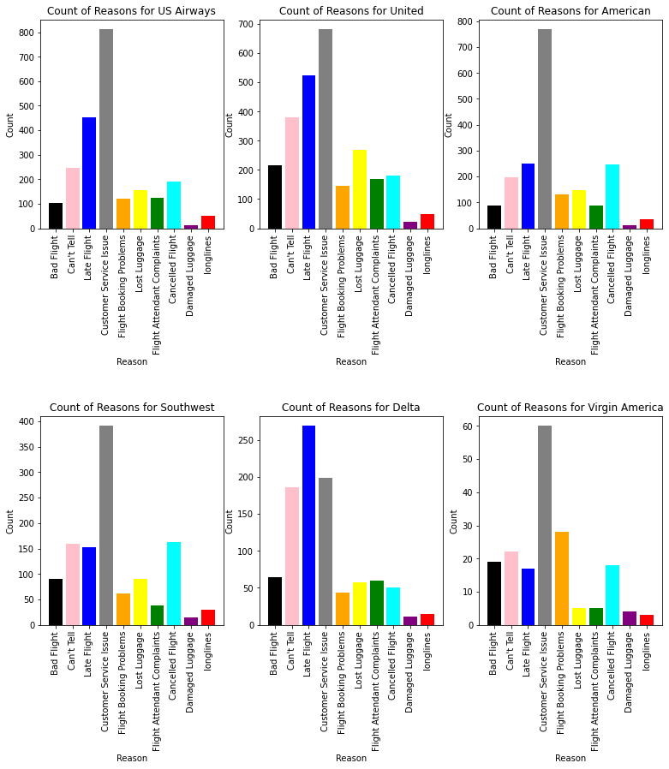
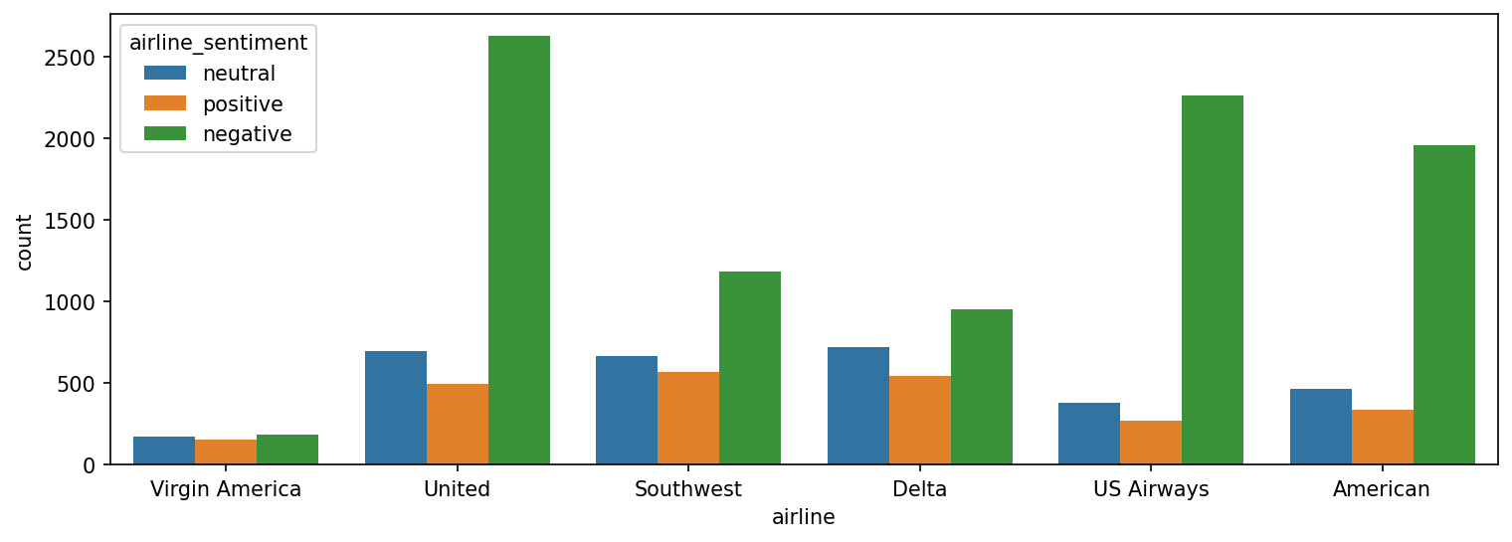
EDA

Slide 5
Preprocessing
Remove stop-words and punctuation
Remove null values

Slide 6
BERT embedding and classification
from simpletransformers.classification import ClassificationModel
# Create a ClassificationModel
bertmodel = ClassificationModel(
'bert', 'bert-base-cased', num_labels=3, use_cuda=True, cuda_device=0,
args={
'reprocess_input_data': True,
"learning_rate": 4e-5,
'overwrite_output_dir': True,
'num_train_epochs': 3, "save_eval_checkpoints": False,
"save_steps": -1,
}
)
# Train the BERT model
bertmodel.train_model(traindf, eval_df=tweets_eval_df)

Slide 7
Classification Report (Before)
precision recall f1-score support
0 0.90 0.91 0.90 1826
1 0.70 0.67 0.69 611
2 0.79 0.78 0.78 491
accuracy 0.84 2928
macro avg 0.80 0.79 0.79 2928
weighted avg 0.84 0.84 0.84 2928

Slide 8
Data Augmentation (Jason Wei et al.)
Synonym Replacement (SR): Randomly choose n words from the sentence that are not stop words. Replace each of these words with one of its synonyms chosen at random. -> from WordNet
Random Insertion (RI): Find a random synonym of a random word in the sentence that is not a stop word. Insert that synonym into a random position in the sentence. Do this n times. -> from WordNet
Random Swap (RS): Randomly choose two words in the sentence and swap their positions. Do this n times.
Random Deletion (RD): Randomly remove each word in the sentence with probability p.

Slide 9
Classification Report (After)
precision recall f1-score support
0 0.90 0.91 0.90 1826
1 0.70 0.67 0.69 611
2 0.79 0.78 0.78 491
accuracy 0.89 2928
macro avg 0.85 0.82 0.84 2928
weighted avg 0.86 0.85 0.84 2928

Slide 10
Thank you
Srichakradhar Reddy N

